Slide 1
Moon-Young Lee’s Nonviolence and Transcendence Ethics in Conflict Management
Hun Myoung Park, Ph.D.
International University of Japan

Slide 2
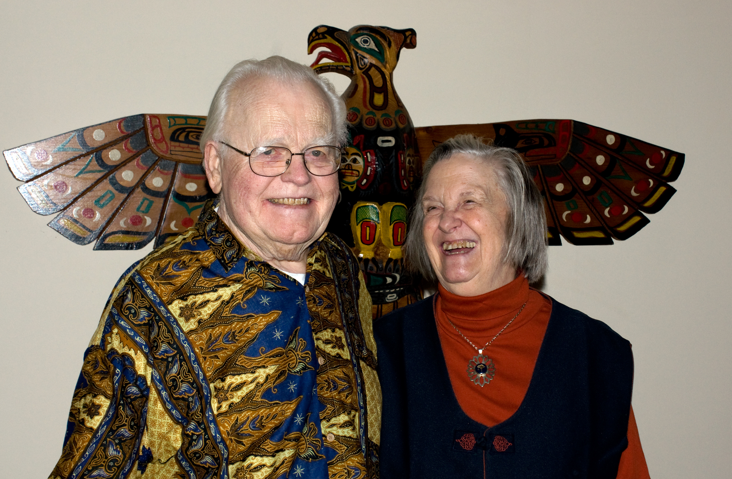

Slide 3
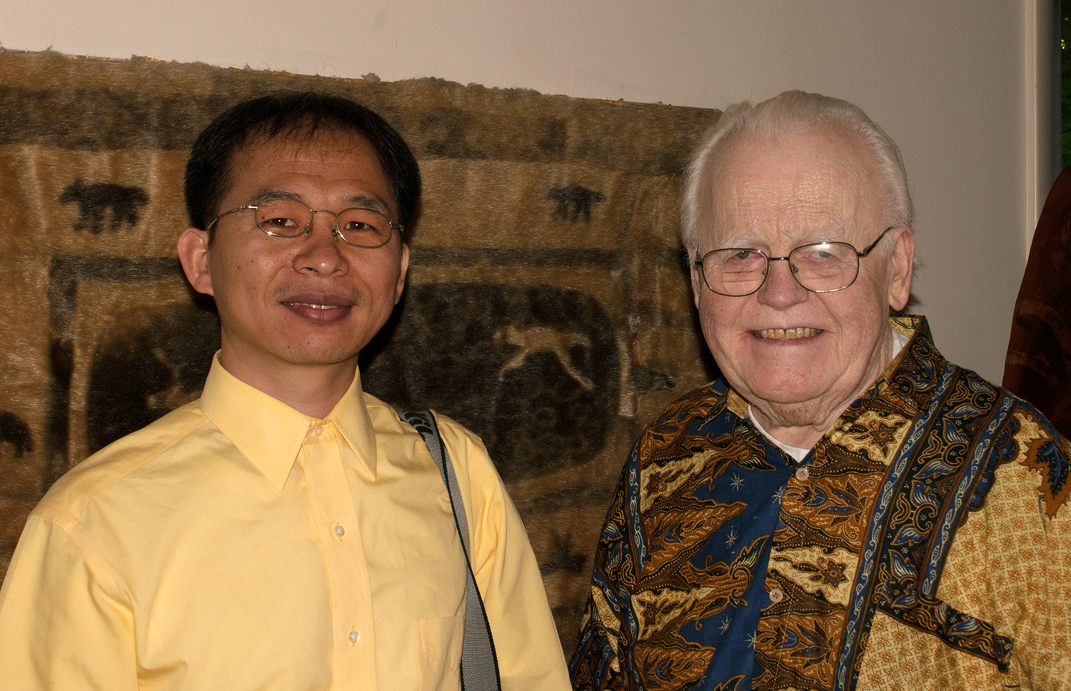

Slide 4
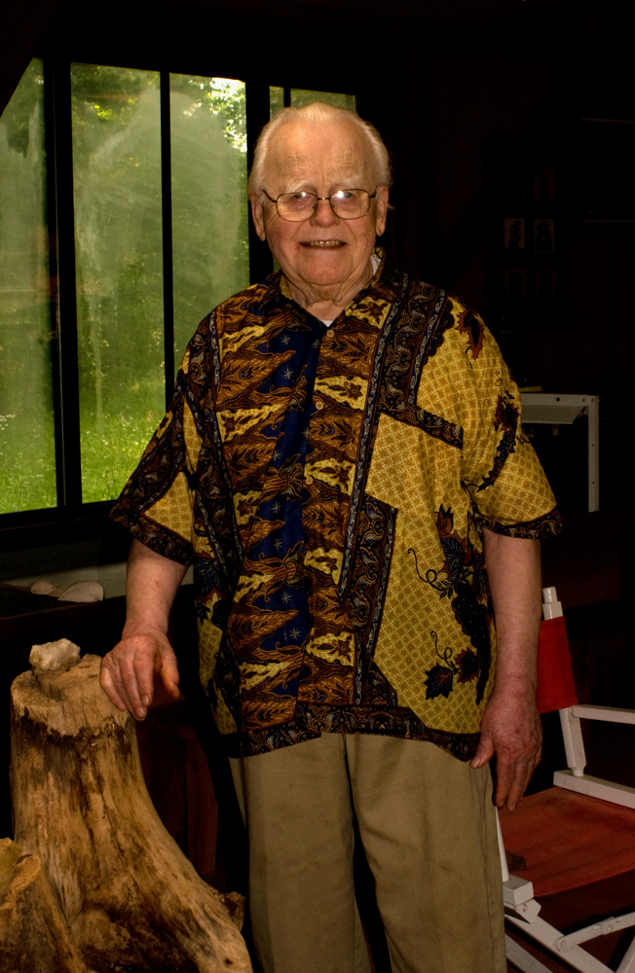
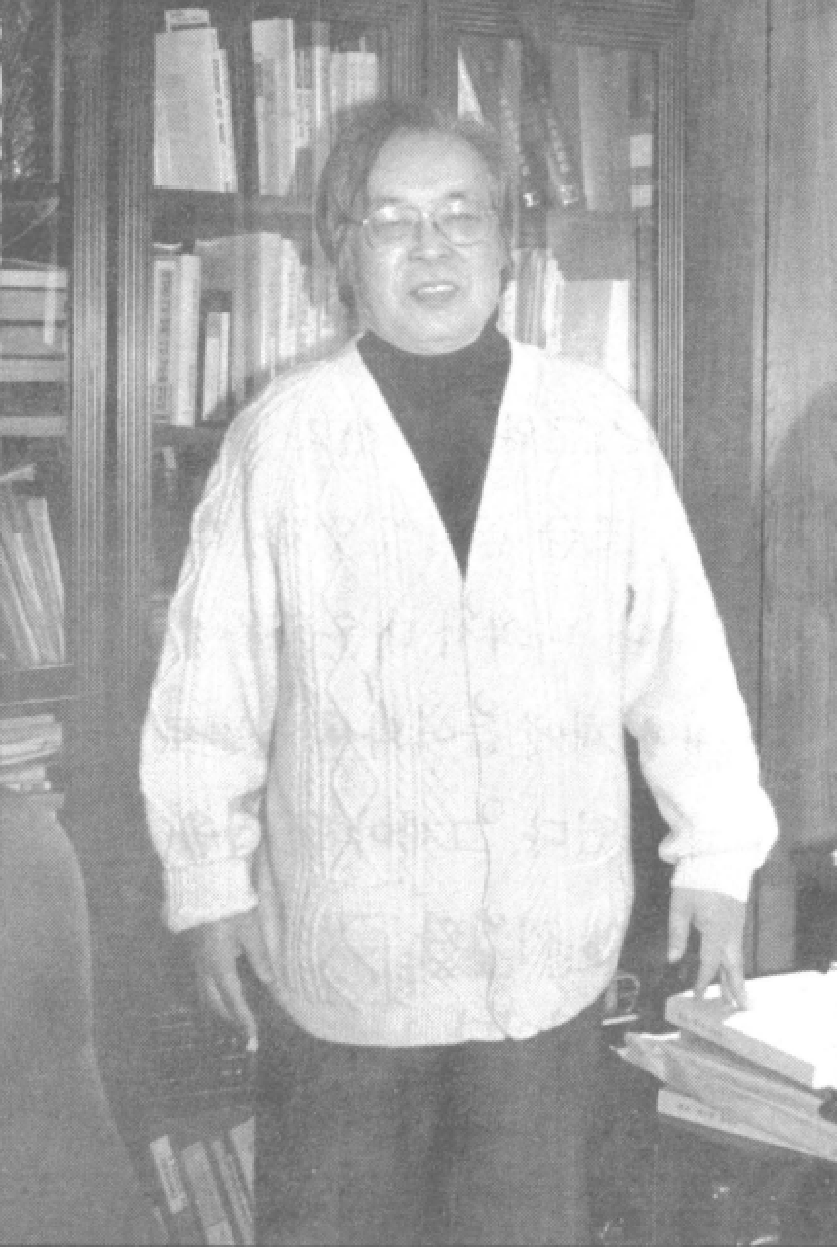

Slide 5
Misbranded Image 1
Lee Moon-Young as
  Pro-democracy fighter,
  Radical left-winger,
  Liberal idealist, or just
  Eccentric man
Rather than public administration scholar?
Stigmatized on purpose

Slide 6
Misbranded Image 2
Lee identifies himself as
  Capitalist (property rights),
  Conservative moderate,
  Glorious Revolutionist (nonviolence),
  Realistic idealist,
  Puritan (conservative),
  Minimalist who makes a minimal and essential request that even evils daren’t rebuff
And public administration scholar

Slide 7
Misbranded Image 3
9th president (1971-1972) of KAPA
Major books
  Autobiographic public administration (1991)
  The Analects of Confucius, the Works of Mencius, and Public Administration (1996)
  Man, Religion, and State (2001)
  Cooperative Governance (2006)
  Public Administration from the March 1st Movement Perspective (2011)
Lee (2006) brought the KAPA award for excellence in academic book in 1997

Slide 8
Misbranded Image 4
Nevertheless,
Lee’s academic effort and performance in public administration are less appreciated than it deserves to be
It is time to evaluate his effort and achievement fairly and impartially

Slide 9
Lee’s Public Administration
Searching for Lee’s framework of public administration
What is his framework or theory?
Is it valid?
What is its theoretical values?
What is its practical values?
What is its implications for public administration (conflict management)

Slide 10
Conceptual Framework 1
People-work-method categorization
  Who? (people with autonomy and discretion)
  What? (meaningful work—effectiveness)
  How? (method or way to improve efficiency)
Transcendence ethics
  Nonviolence
  Personal ethic
  Social ethic
  Self-sacrifice

Slide 11
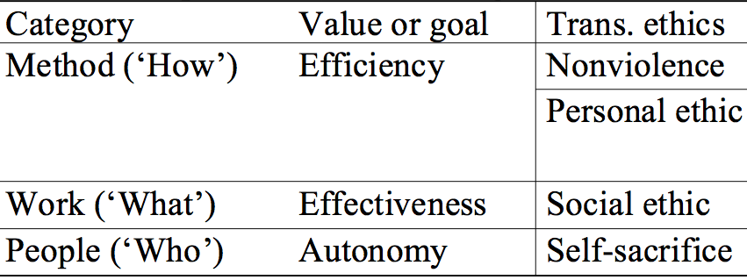
Conceptual Framework 2

Slide 12
Transcendence Ethics 1
From Four Gospels of Holiness Church
  Holiness (聖潔) → Nonviolence
  Healing (神癒) → Personal ethic
  Second coming (再臨) → Social ethic
  Rebirth (重生) → Self-sacrifice
Why transcendence? A maturity process of transcending one step to the other
Ethics, abilities, alternatives, (strategies)

Slide 13
Transcendence Ethics 2
Nonviolence
  Give up using violence
  Use ‘word’
  Tell the right things or truth only
  E.g., refusal of spoils system
Personal ethic
  Specialized knowledge and skills
  Pursue agreement and cooperation
  E.g., scientific human resource management and human relations
Social ethic (e.g., welfare) and self-sacrifice

Slide 14
Transcendence Ethics 3
From five basic human natures (五常)
Nonviolence: Spring
  Trust (信)
Personal ethic: Summer
  Knowledge (智)
  Propriety (禮)
Social ethic: benevolence (仁): Autumn
Self-sacrifice: righteousness (義): Winter

Slide 15
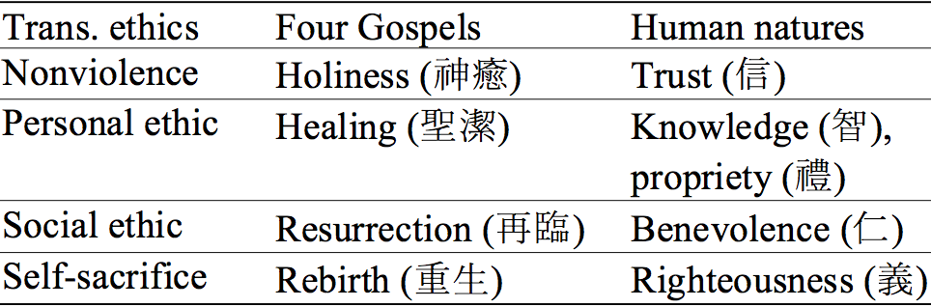
Transcendence Ethics 4

Slide 16
Lee’s Nonviolence
No to use violence
Use ‘word’
Tell only right things (truth)
Complete nonviolence without emotional release and enmity (plain speaking)
Minimum that is fundamental and essential
Grounded on laws, procedures, agreement, common sense, etc.

Slide 17
Why Nonviolence?
The weak have no strong power
The weak will be worse off from violence
The weak can protect themselves from violence
Promising weapon to defeat the strong
Normative rationale grounded on philosophical and religious belief, and pro-democracy struggles.

Slide 18
Why in Conflict Management
Transcendence ethics assume a conflict situation
Bureaucratic model of conflict between superior and subordinator
How can the weak survive from power abuse and reach an agreement (e.g., democracy and peace) without bloody struggles?

Slide 19
Pondy’s Conflict Episode 1
Pondy (1967 and 1992)
Conflict exists everywhere
Conflict as a “sequence of interlocking conflict episode” rather than an event
Conflict is not necessarily bad
Conflict can be functional and constructive
General conflicts (excluding power of violence)

Slide 20
Pondy’s Conflict Episode 2
Antecedent conditions
Latent conflict stage
Perceived conflict stage
Felt conflict
Manifest conflict
Conflict aftermath
Not necessarily go through every stages one by one

Slide 21
Getting to Yes (2011) 1
Fisher, Ury, and Patton (2011)
Positional bargaining
  Hard bargaining
  Soft bargaining
Principled negotiation as an alternative to positional bargaining to reach agreement efficiently and amicably

Slide 22
Getting to Yes (2011) 2
Problem solvers independent of trust
Separate people from problem
  Be soft on people and hard on problems
Focus on interests not positions
  Explore interests behind positions
Invent options for mutual gain
Insist on using objective criteria

Slide 23
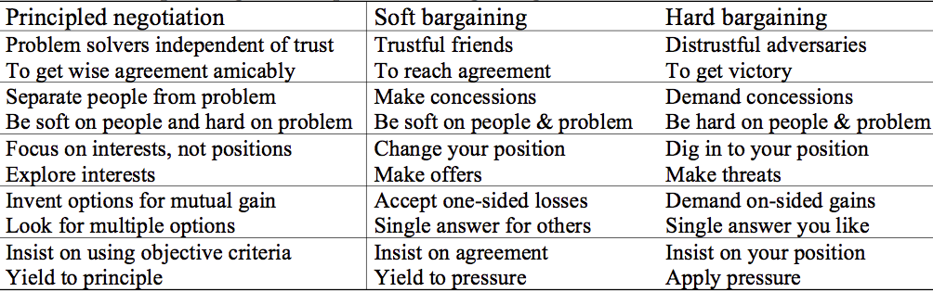
Getting to Yes (2011) 3

Slide 24
Getting to Yes (2011) 4
Use BATNA under adverse conditions
Best Alternative to a Negotiated Agreement (BATNA)
Rather weak explanation
Lee’s nonviolence appears to be BATNA under adverse conditions

Slide 25
Lieutenant’s Gentle Revolt 1
Conflict between an authoritative general and lieutenant with managerial leadership
Well prepared revolt at the right time
Show how conflict episodes are applied
“Textbook reading” “Working to rules” “Emotion zero” strategies
Self-collapsed general’s leadership
Power of nonviolence and personal ethic

Slide 26
Lieutenant’s Gentle Revolt 2
Comprehensive reaction scenario needed
Recognize dynamics of conflicts (reality and conflict episodes)
Wait until the right time comes
Goading effect to the strong who gets mad and makes mistakes consecutively
Importance of complete nonviolence (separate people from problems)
Practical and powerful weapon for the weak

Slide 27
Conclusion
Lee as a Korean Puritan who studied PA
Lee’s nonviolence and personal ethic are comparable to conflict management literature
Nonviolence and personal ethic as dominant strategies for the weak to confront the strong
Realistic and practical although not easy to put them into real conflict circumstance
Be patient, avoid violence, tell the truth.

